Slide 1
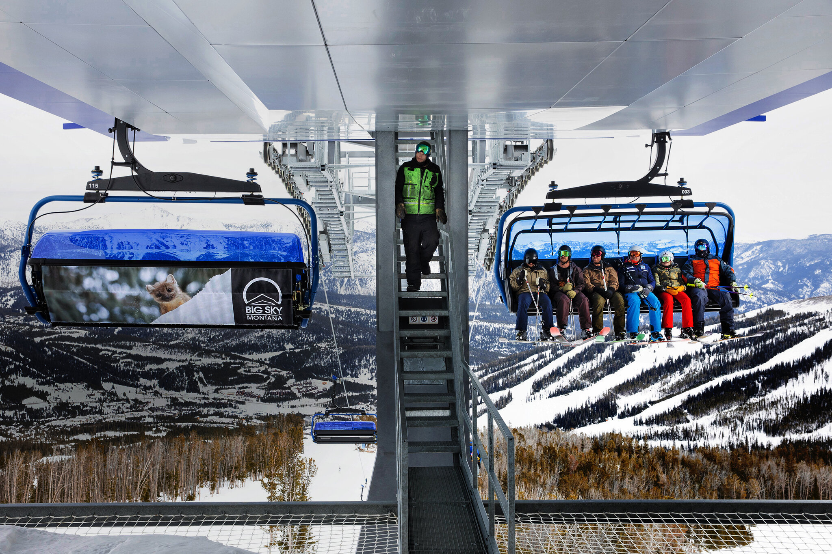
Big Mountain Resort Ticket Pricing Model

Slide 2
Problem identification
The company Big Mountain Resort provides some facilities for skiers and riders of all levels and abilities.
This company has recently installed an additional facility which increases their operating costs this season. So, the business wants some guidance on how to:
Select a better value for their ticket price.
Consider several changes either to cut costs without undermining the ticket price or to support an even higher ticket price.

Slide 3
Key findings
1- Permanently closing down up to 10 of the least used runs.
Closing one run makes no difference.
Closing more than one runs successively reduces support for ticket price and revenue.
2- Increase the vertical drop by 150 feet and adding a run.
Lower increases support for ticket price by $1.99 and possible increasement in revenue $3.47 million.
3- Same as number 2, plus adding 2 acres of snow making cover.
Does not affect on the ticket price and the revenue.
4- Increase the longest run by 0.2 mile to boast 3.5 miles length, requiring an additional snow making coverage of 4 acres.
No difference is observed.

Slide 4
Recommendation
In this business problem, the second scenario, increase the vertical drop by 150 feet and adding a run that leads to increase support for ticket price by $1.99 and also possible expected increase in revenue is $3.47 million is selected as the best strategy among others.

Slide 5
Modeling
 | performance using CV | performance using CV |  | Ticket price
 | Mean | MAE | Std | MAE | Std
Linear Regression | 14.11 | 0.63 | 0.09 | 10.5 | 1.62
Random Forest Regression | 9.54 | 0.71 | 0.069 | 9.58 | 1.37
The random forest model has a lower cross-validation mean absolute error by almost $1. It also exhibits less variability. Verifying performance on the test set produces performance consistent with the cross-validation results.

Slide 6
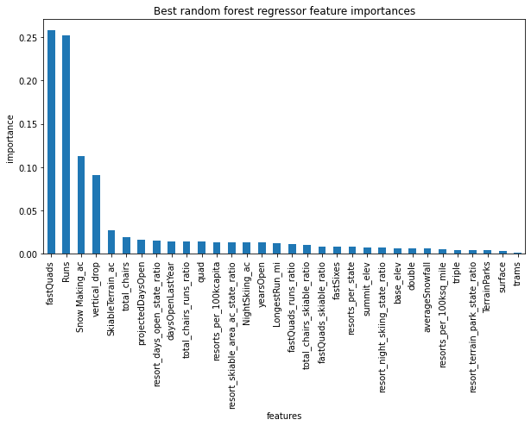
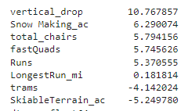
Feature Importance
Linear Regression Model Random Forest Regression Model
The dominant top four features are in common are:
fastQuads, Runs, Snow Making_ac, vertical_drop

Slide 7
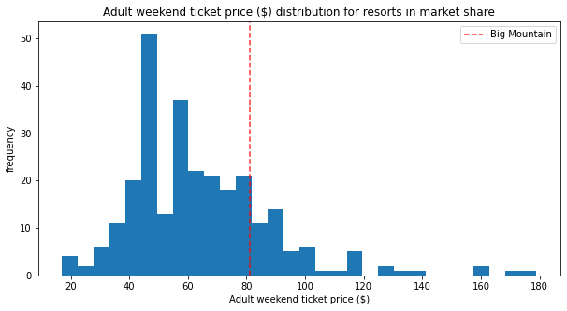
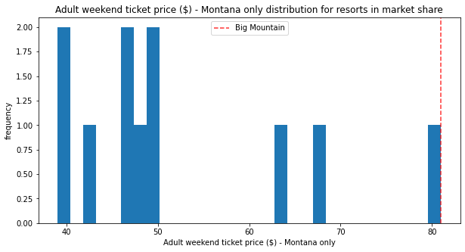
Big Mountain Resort Ticket Prices

Slide 8
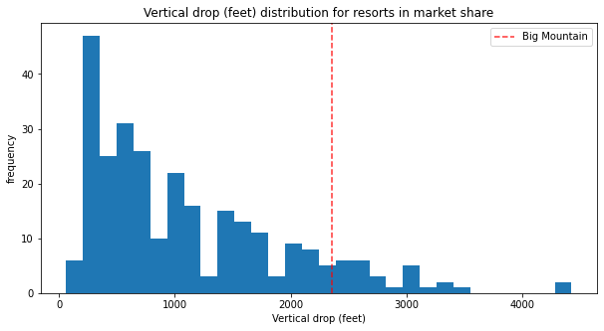
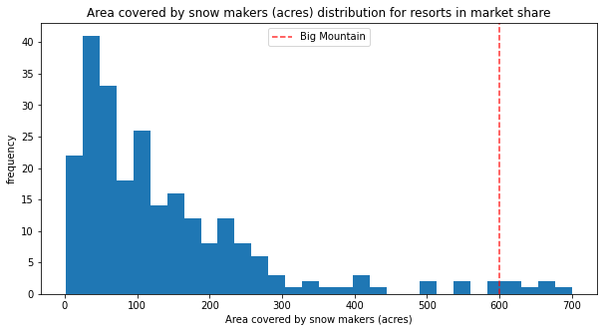
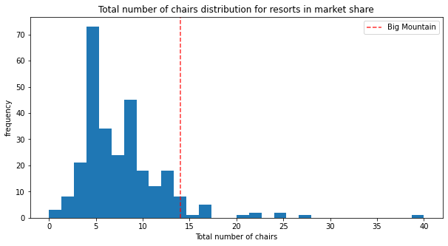
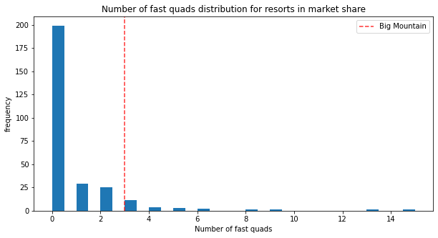
Facilities Comparison of Ski Resorts

Slide 9
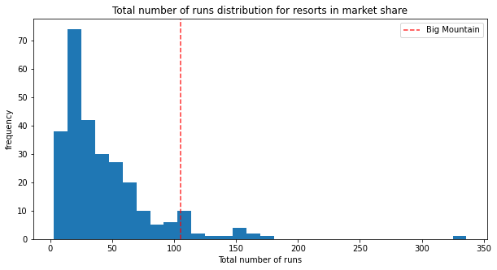
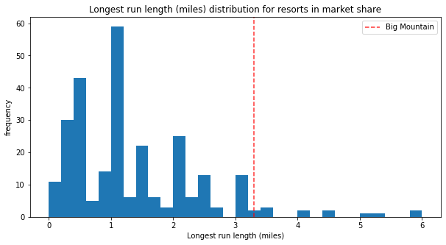
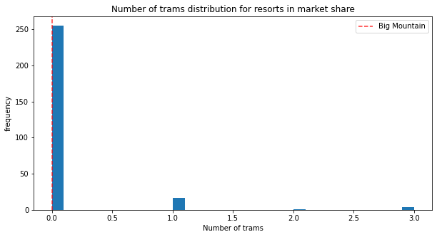
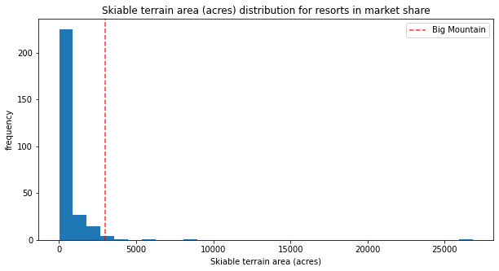
Facilities Comparison of Ski Resorts

Slide 10
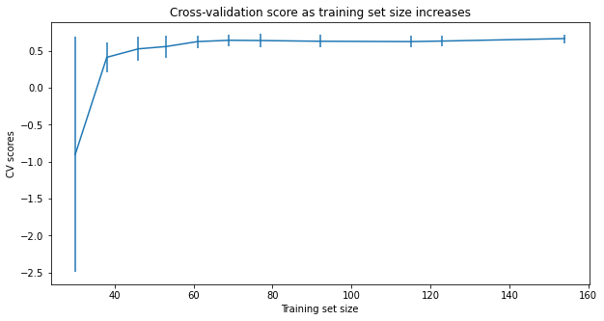
Data quantity
The plot of cross-validation against training set size shows that it seems there is plenty of data. There's an initial rapid improvement in model scores as one would expect, but it's essentially levelled off by around a sample size of 40-50.

Slide 11
Summary
Big Mountain Resort modelled price is $96.32, actual price is $81.00. Even with the expected mean absolute error of $10.41, this suggests there is room for an increase.
Increase the vertical drop by 150 feet and adding a run results in lower increases support for ticket price by $1.99 and possible increasement in revenue $3.47 million.

